Slide 1
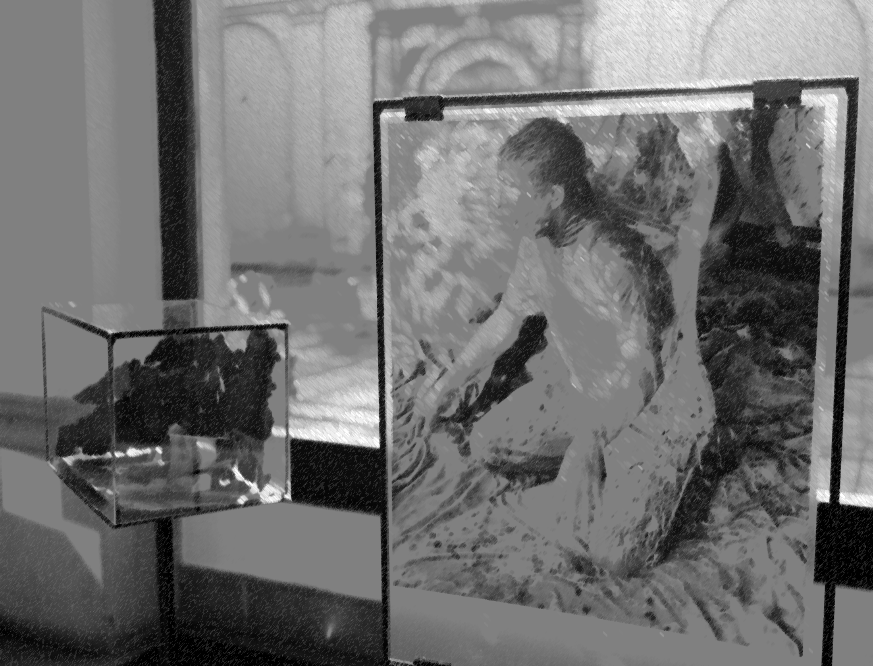
Routes, paths and intersections of art and education
Constants and variables of research into the innovative aspects of the development of art education in the Czech Republic and Central Europe
Doc. Hana Stehlíková Babyrádová
Faculty of Education of Masaryk University, Brno,
Czech Republic 2014

Slide 2
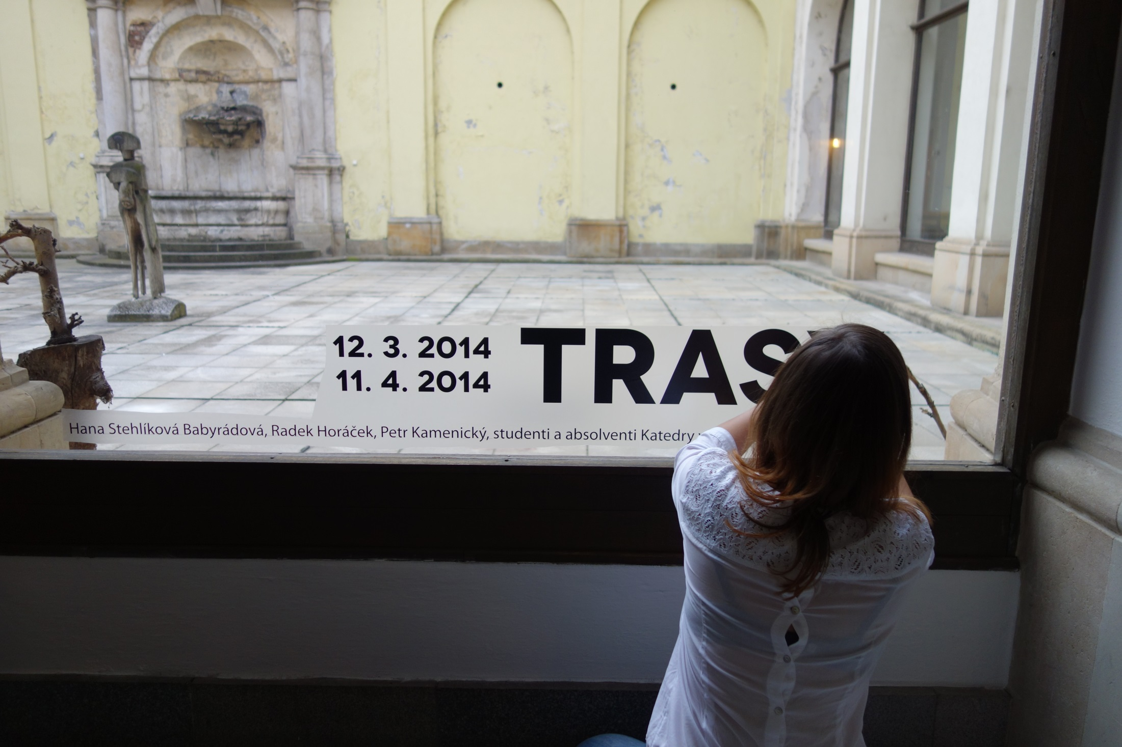

Slide 3
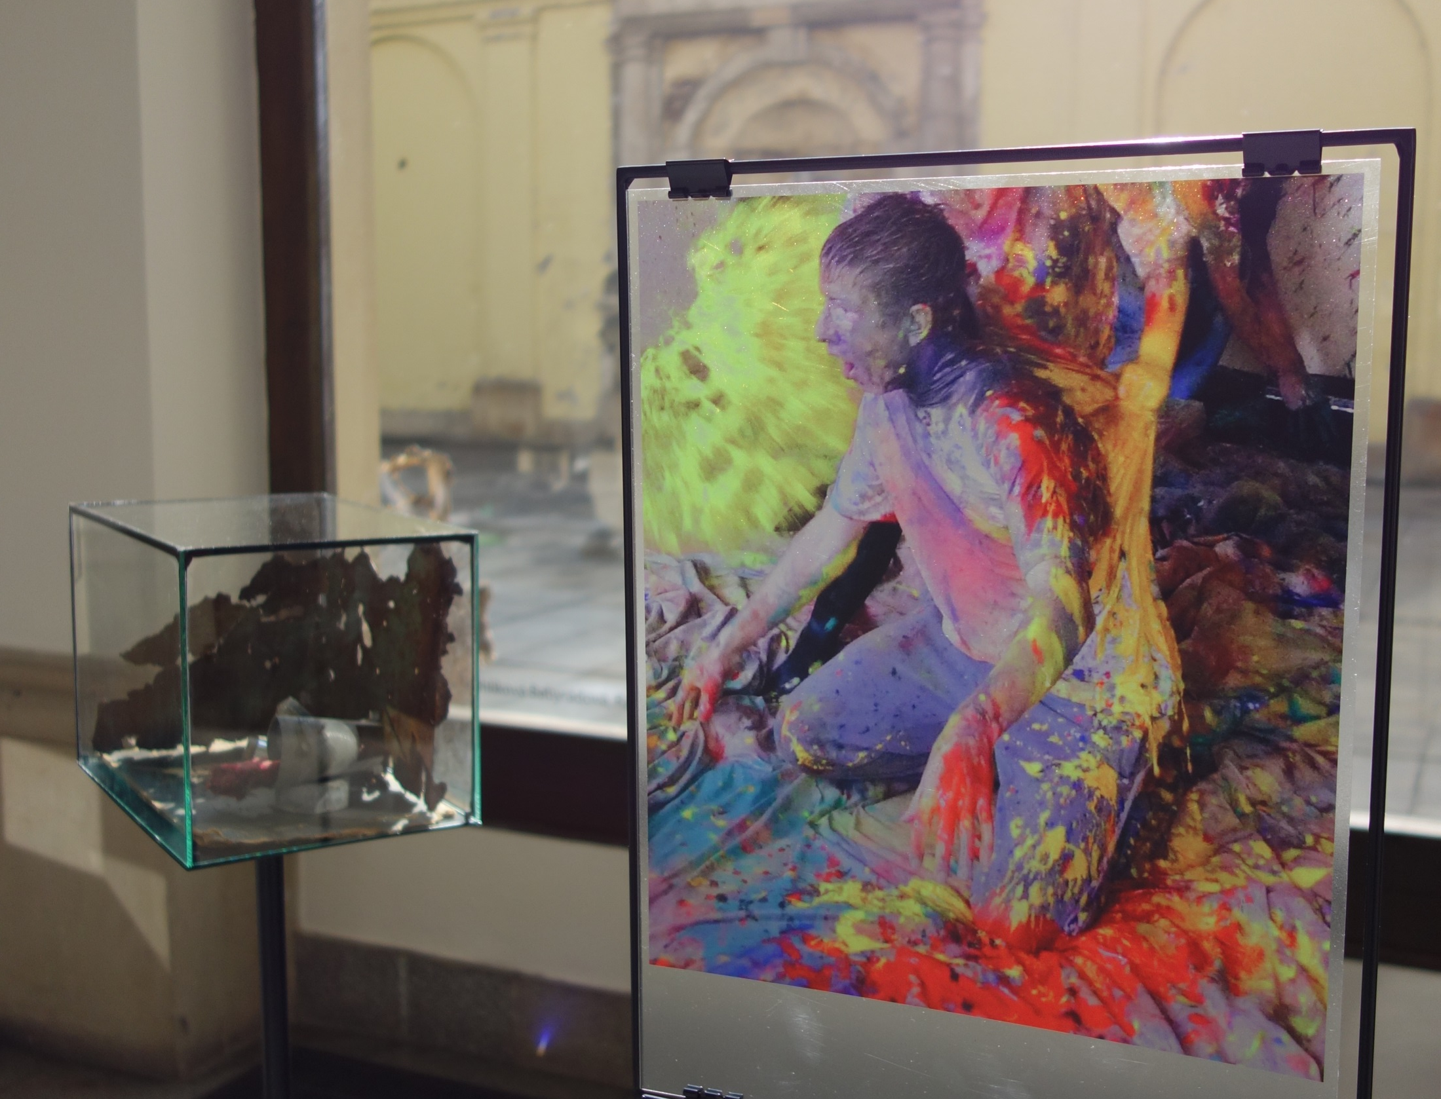

Slide 4
This paper presents the results of qualitative research into the interfaces of the development of fine arts and education, performed in the years 2013-14 at the Department of Art of the Faculty of Education of Masaryk University, Brno, in the Czech Republic. Examples of artworks and educational events and projects of artists who are also teachers at the university (Hana Stehlíková Babyrádová, Petr Kamenický, Radek Horáček, Masaryk University, Brno) were selected to monitor the analogies, lasting relations and systemic links between the “past”, “present” and “future” of art and education.
Art here includes both physical pieces as well as conceptual and intermedial works.

Slide 5
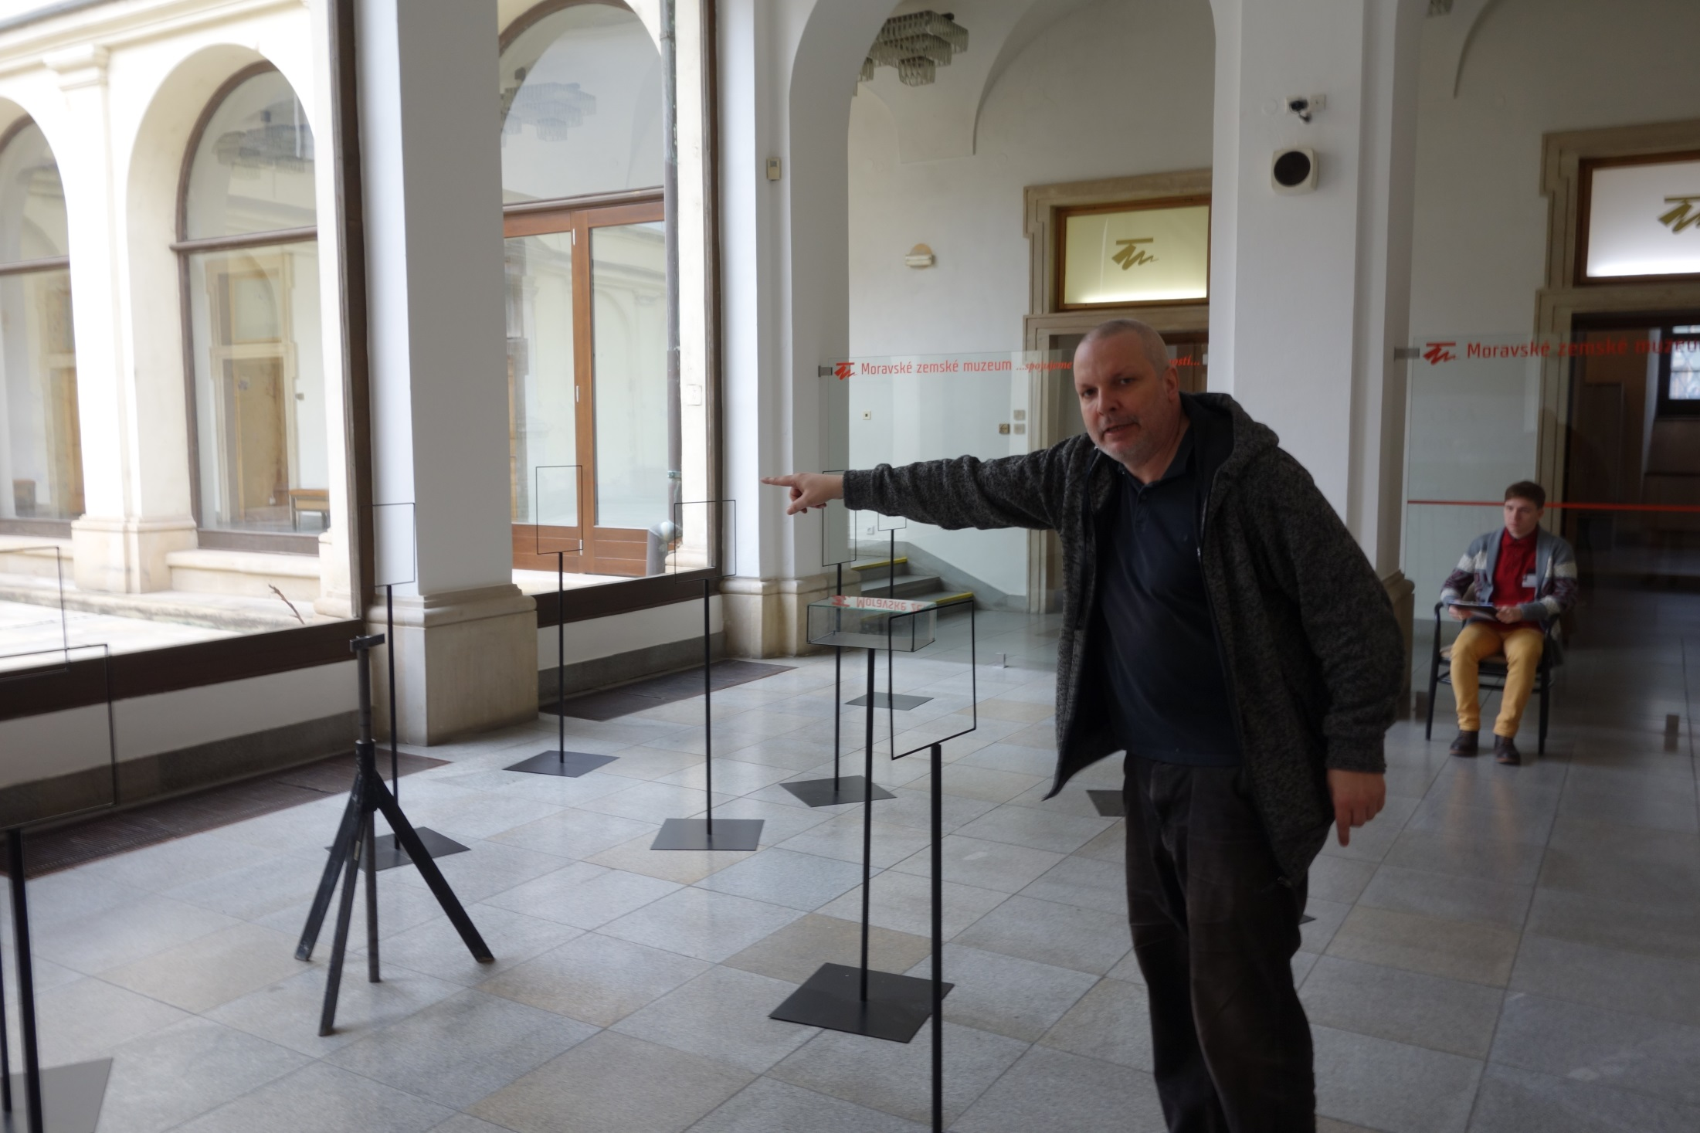
Starting of artistic exibition in Museum, which has also some educational aims

Slide 6
Research methodology
In the form of text case studies and using hermeneutic interpretation the author presents the results of mapping specific activities related to the teaching of art education at faculties of education in the Czech Republic and Central Europe. We use selected examples to demonstrate the results of the investigation of a wide range of similarities and differences between the activities of teachers and their students. The interpretive commentaries present key ideas emerging both in higher education as well as in art. In the reflective part we propose the possibilities of further innovation in artistic and educational projects.

Slide 7
Presentation of the results of the research
During the research we determined a positive analogy between art and education in the following areas: art and education are based on the application of the principles of games, rituals, performativity and intermediality.
A selection of photographs of works of teachers and students monitors the key achievements of individuals that are valuable in terms of the fact that they were, are, and probably will be in the future a kind of “universal” of communication through art. Artistic and pedagogical projects in their universality can serve as a means of interpersonal communication and teaching.

Slide 8
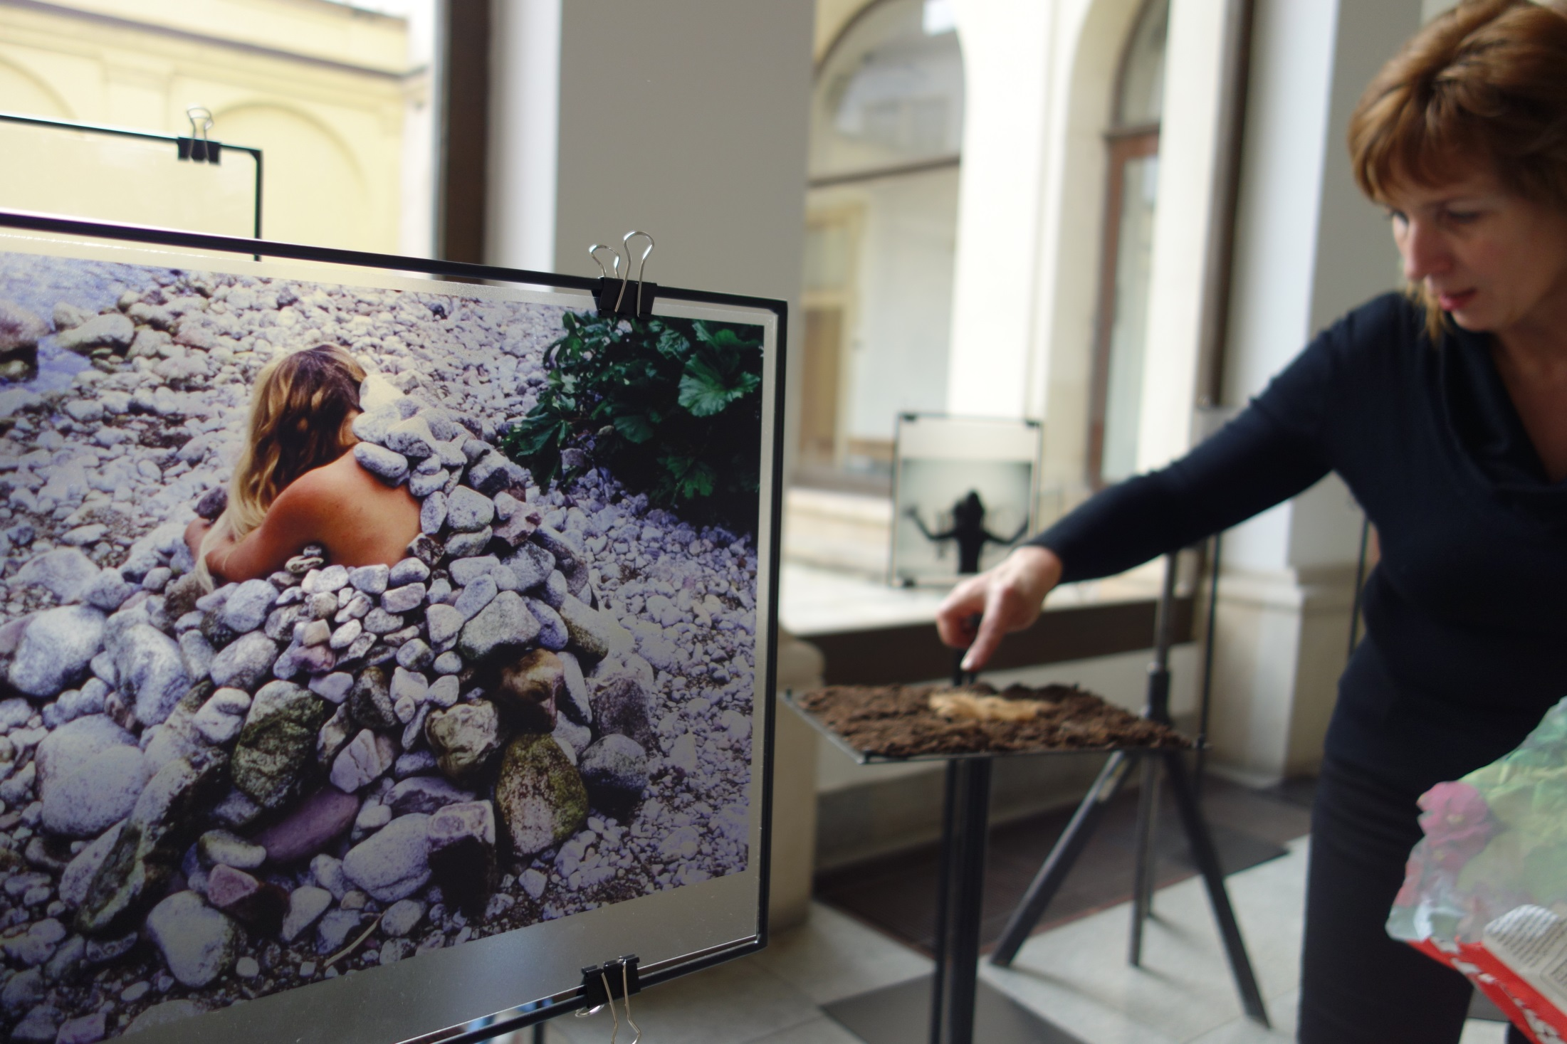
The Photo – Performance of Hana Stehlíková Babyradova 1994 and in 2014 instalation of Hana Stehlikova Babyradova as artist and also teacher

Slide 9
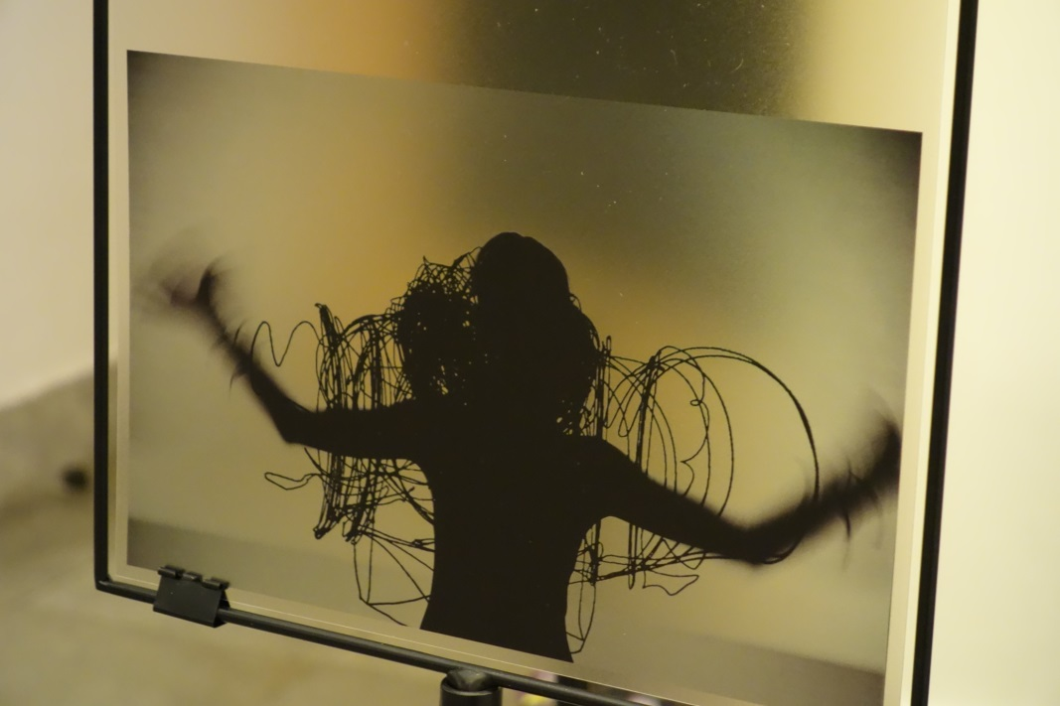
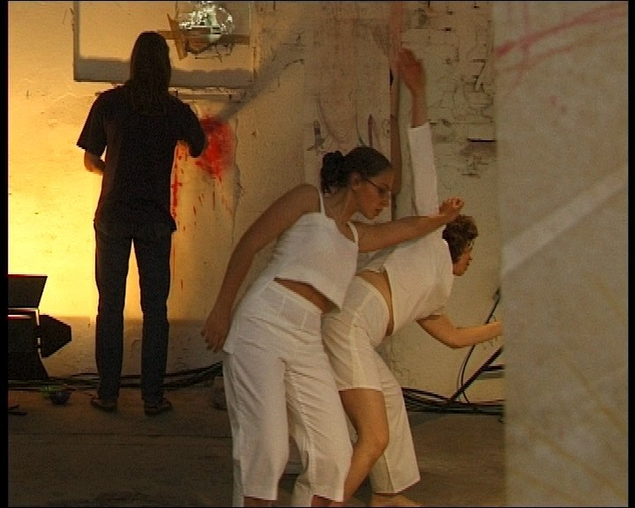
Documentation of students performance linking expressive dance and artwork placed on stands, with documentation related the events performed by a teacher.

Slide 10
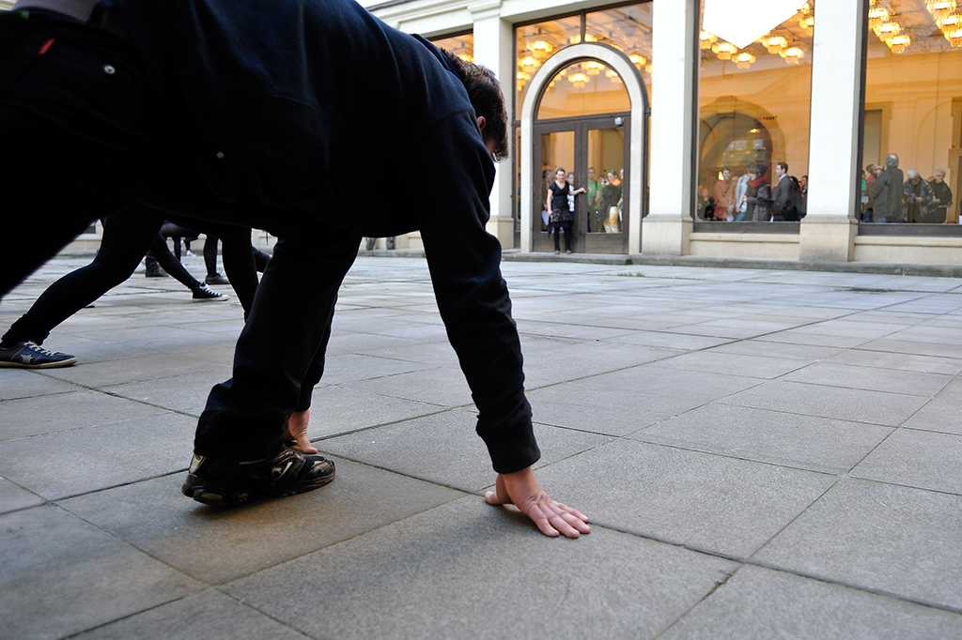
Photo documentation of the opening of the exhibition Routes captures the performance of students of the University, which is symbolized by a short run to a set of glass windows where visitors have to mirror the movements of each of the performers.

Slide 11
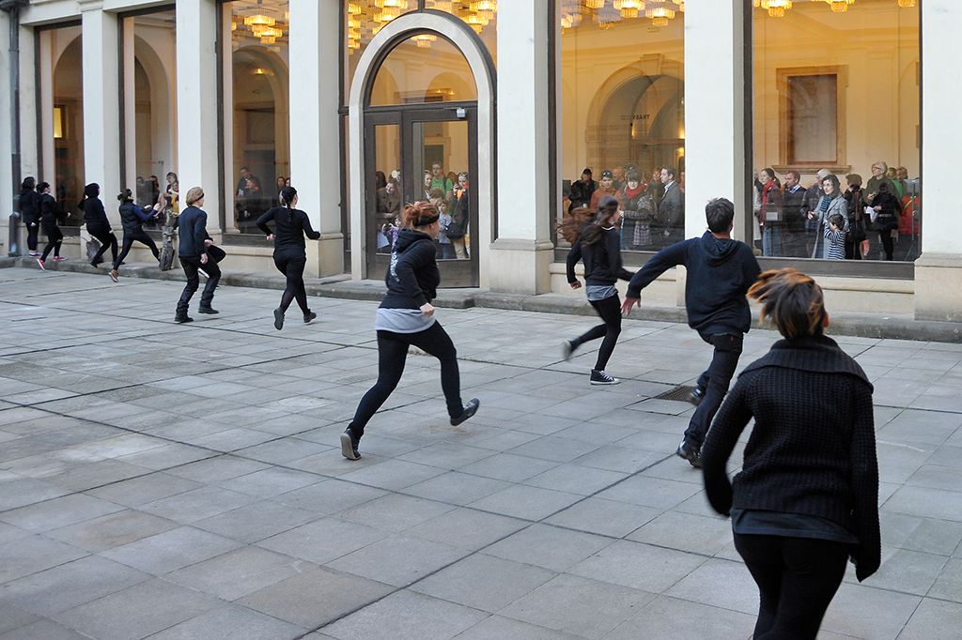

Slide 12
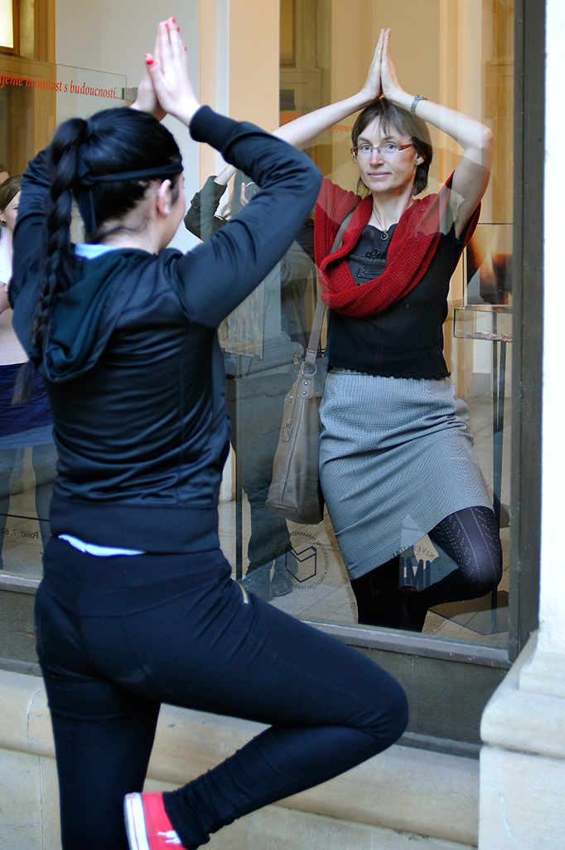
The act of the mirrored movement. The audience engaging in the performance work revived the whole exhibition and their participation became part of the exhibition.

Slide 13
The hypothesis of the research was verified through qualitative research and was presented in a unique exhibition entitled Routes (the Czech Republic, Brno, Moravian Museum 2014), where students were able to learn about its form and a sample of selected works and projects of the author of this contribution. Expert commentary on the results of the research embodied by the exhibition will be accompanied by a commentary of photographs, relics and excerpts of texts reflecting the specific events monitored during the research.

Slide 14
Thesis
Routes between artists, teachers and students are medium of education

Slide 15
The project did not aim to didactically map the activities on both sides but to tend towards initiating an investigation of the wide range of similarities and differences between the activities of teachers and their pupils. The collection of photographs documenting the activities of those who have meet at the Department of Art over a period of more than two decades calls for reflection – and immediately in several ways. The themes unearthed during the project can be formulated into the following questions: What are the sources of art in several converging areas of artistic and non-artistic expression? Where are the paths leading to the creation of this art directing to and how is the creative energy transferred between the two parties?

Slide 16
We live in a world of perfectly developed network technology: we know everything about everything, we are connected by our knowledge. The mystery remains whether just as quickly and easily we can connect our lives, during which we travel along many routes that cannot be united into a single line. Our movements, actions and thoughts branch out from the main trunk of the tree of our being and can intertwine and merge or merely touch other branches of the “tree”.

Slide 17
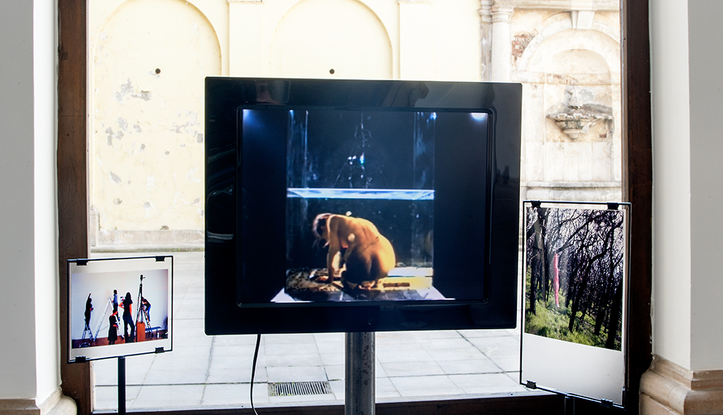
Working with the body is a key theme for the artist. This type of artistic expression - performance - is also popular with a wide range of students. Similar actions can be found in dissertations and diploma theses produced without their authors imitating their teacher.

Slide 18
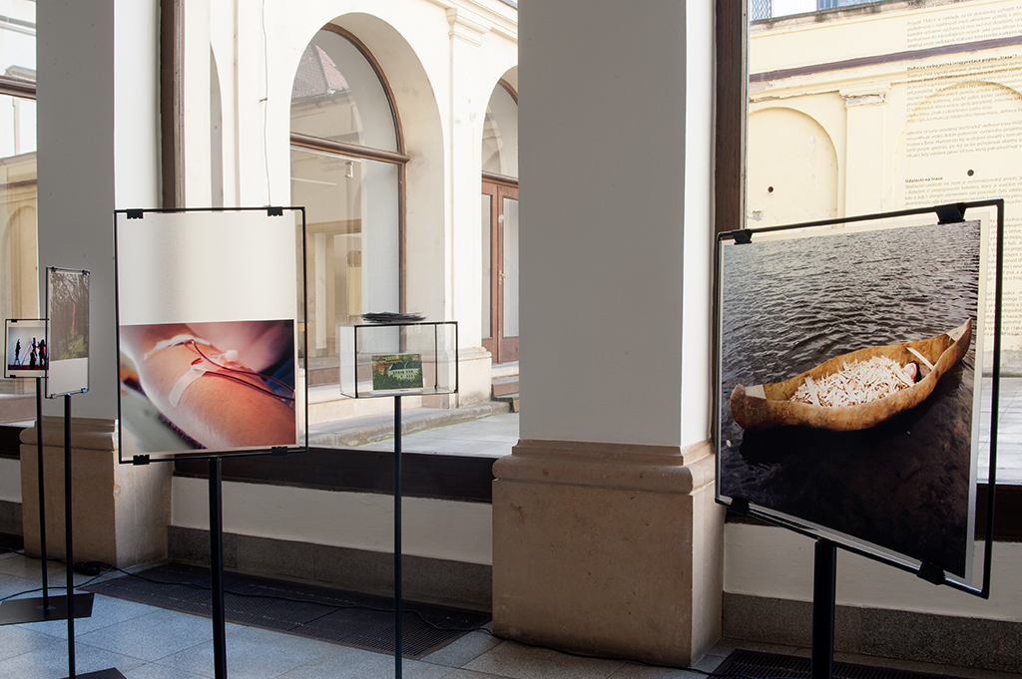
Students’ work on a photo called The watter is away is analogous of the performative activities of the artist and teacher Petr Kamenický

Slide 19
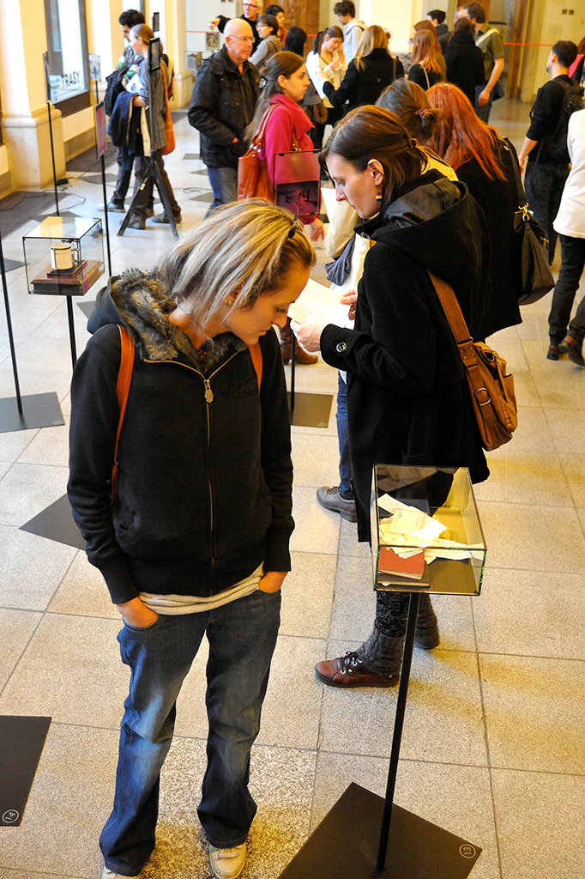
Opening of the exibition Routh

Slide 20
In the project we counted on the fact that art, education and a blending of the two areas can be compared to the tree, whose main principle is the intertwining of the branches.
Whereas an engineer is able to construct an exact map of the route along whose lines a machine works, a humanist and in particular an artist or teacher can only suspect the existence of such a map. They would only rarely try to draw the map and look at their past and present at an objective distance. The exhibition entitled Routes can be regarded as a unique attempt to create such a perspective. It does not form a final version of a plan or scheme in a technical sense but rather it provides a “look back” into the past, an “insight” into the present and a “view” to the future.

Slide 21
The exhibition Routes was installed in the foyer of the Moravian Museum in Brno, signs were placed on glass on the boundary of the internal and external areas of the museum (environmental installation linking everything together)

Slide 22
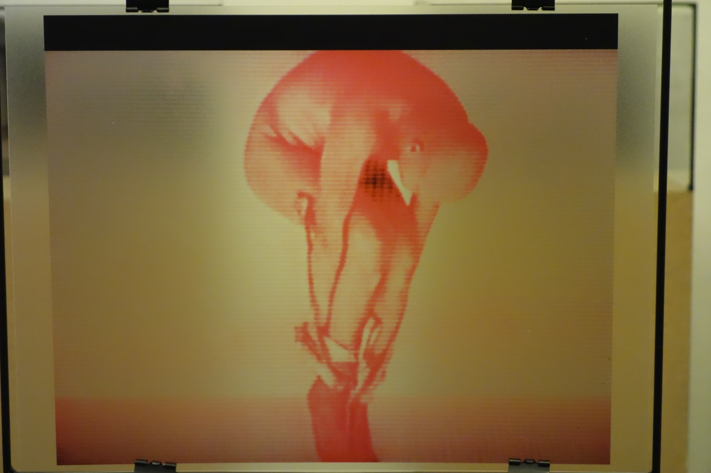
Event showing the art of the teacher Petr Kamenický, Brno, working with the body is a key theme for the artist. This type of artistic expression - performance - is also popular with a wide range of students. Similar actions can be found in dissertations and diploma theses produced without their authors imitating their teacher.

Slide 23
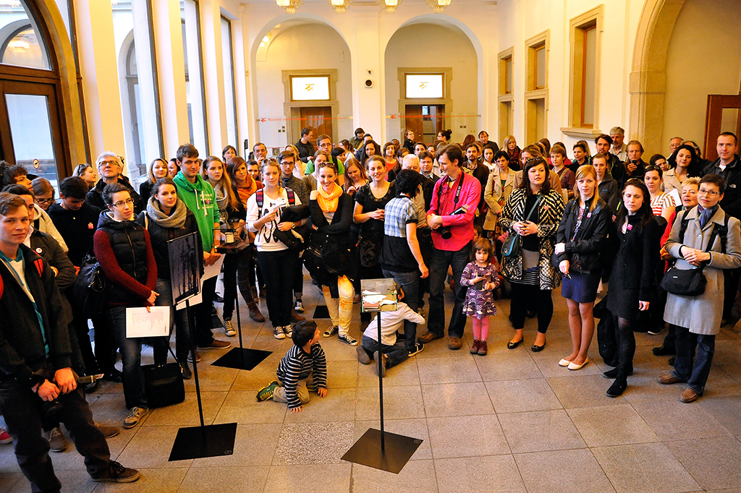
Opening of the exibition

Slide 24
In the framework of the presentation of the research results visitors were offered the opportunity to follow the documentation of the actions and works of three university teachers, who have initiated dozens of actions and works of students – both consciously and unconsciously - over a period of twenty years. The directions determining motivational energy are, however, multilateral: the teacher inspires the pupil, the pupil inspires the teacher, the pupil performs something that the teacher already knows, and without either of them knowing analogy arises that may or may not be a work of coincidence.

Slide 25
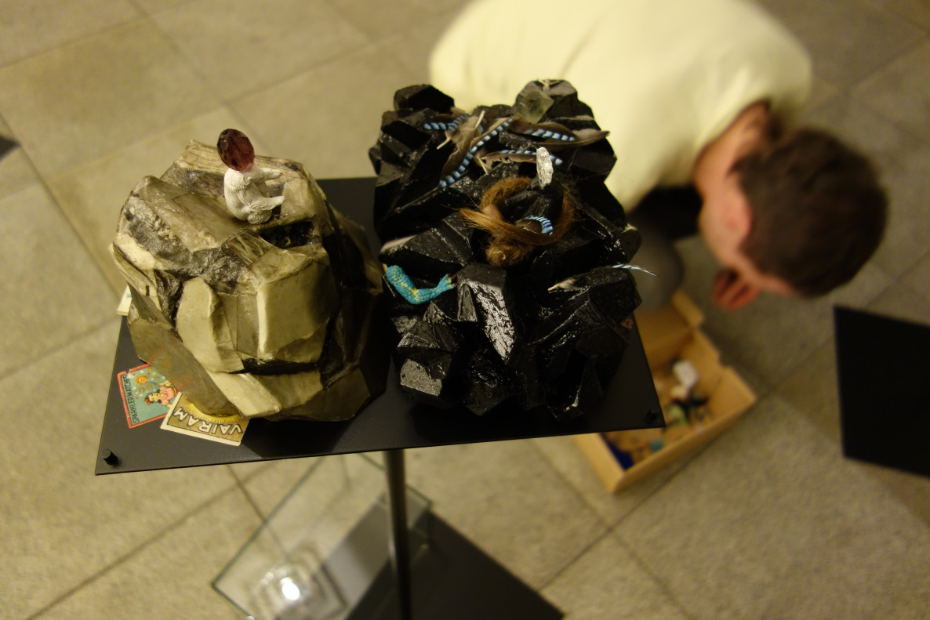
Petr Kunčík, graduate of the Department of Art, completely independently links his installations to the exhibition. It is an installation entitled Petra, which his girlfriend Dita - another graduate of the Department- also contributed to. Both use small items from their apartment. It deals with autobiographical material similar to my case. Petr teaches at a high school and also does similar things with his students.

Slide 26
Conclusion
Recommended models for teaching art at the Faculty of Education of Masaryk University in Brno:
The obtained results indicate that in art education there are often very strong analogies between the work of the teacher and the student. An example of the art at a show or exhibition may serve as a useful tool for university education. A dialogue between the teacher and the student then follows, which usually results in the student creating a completely new piece of work that may draw on the theme of the art of the teacher but is an original performance in a new time and place.

Slide 27
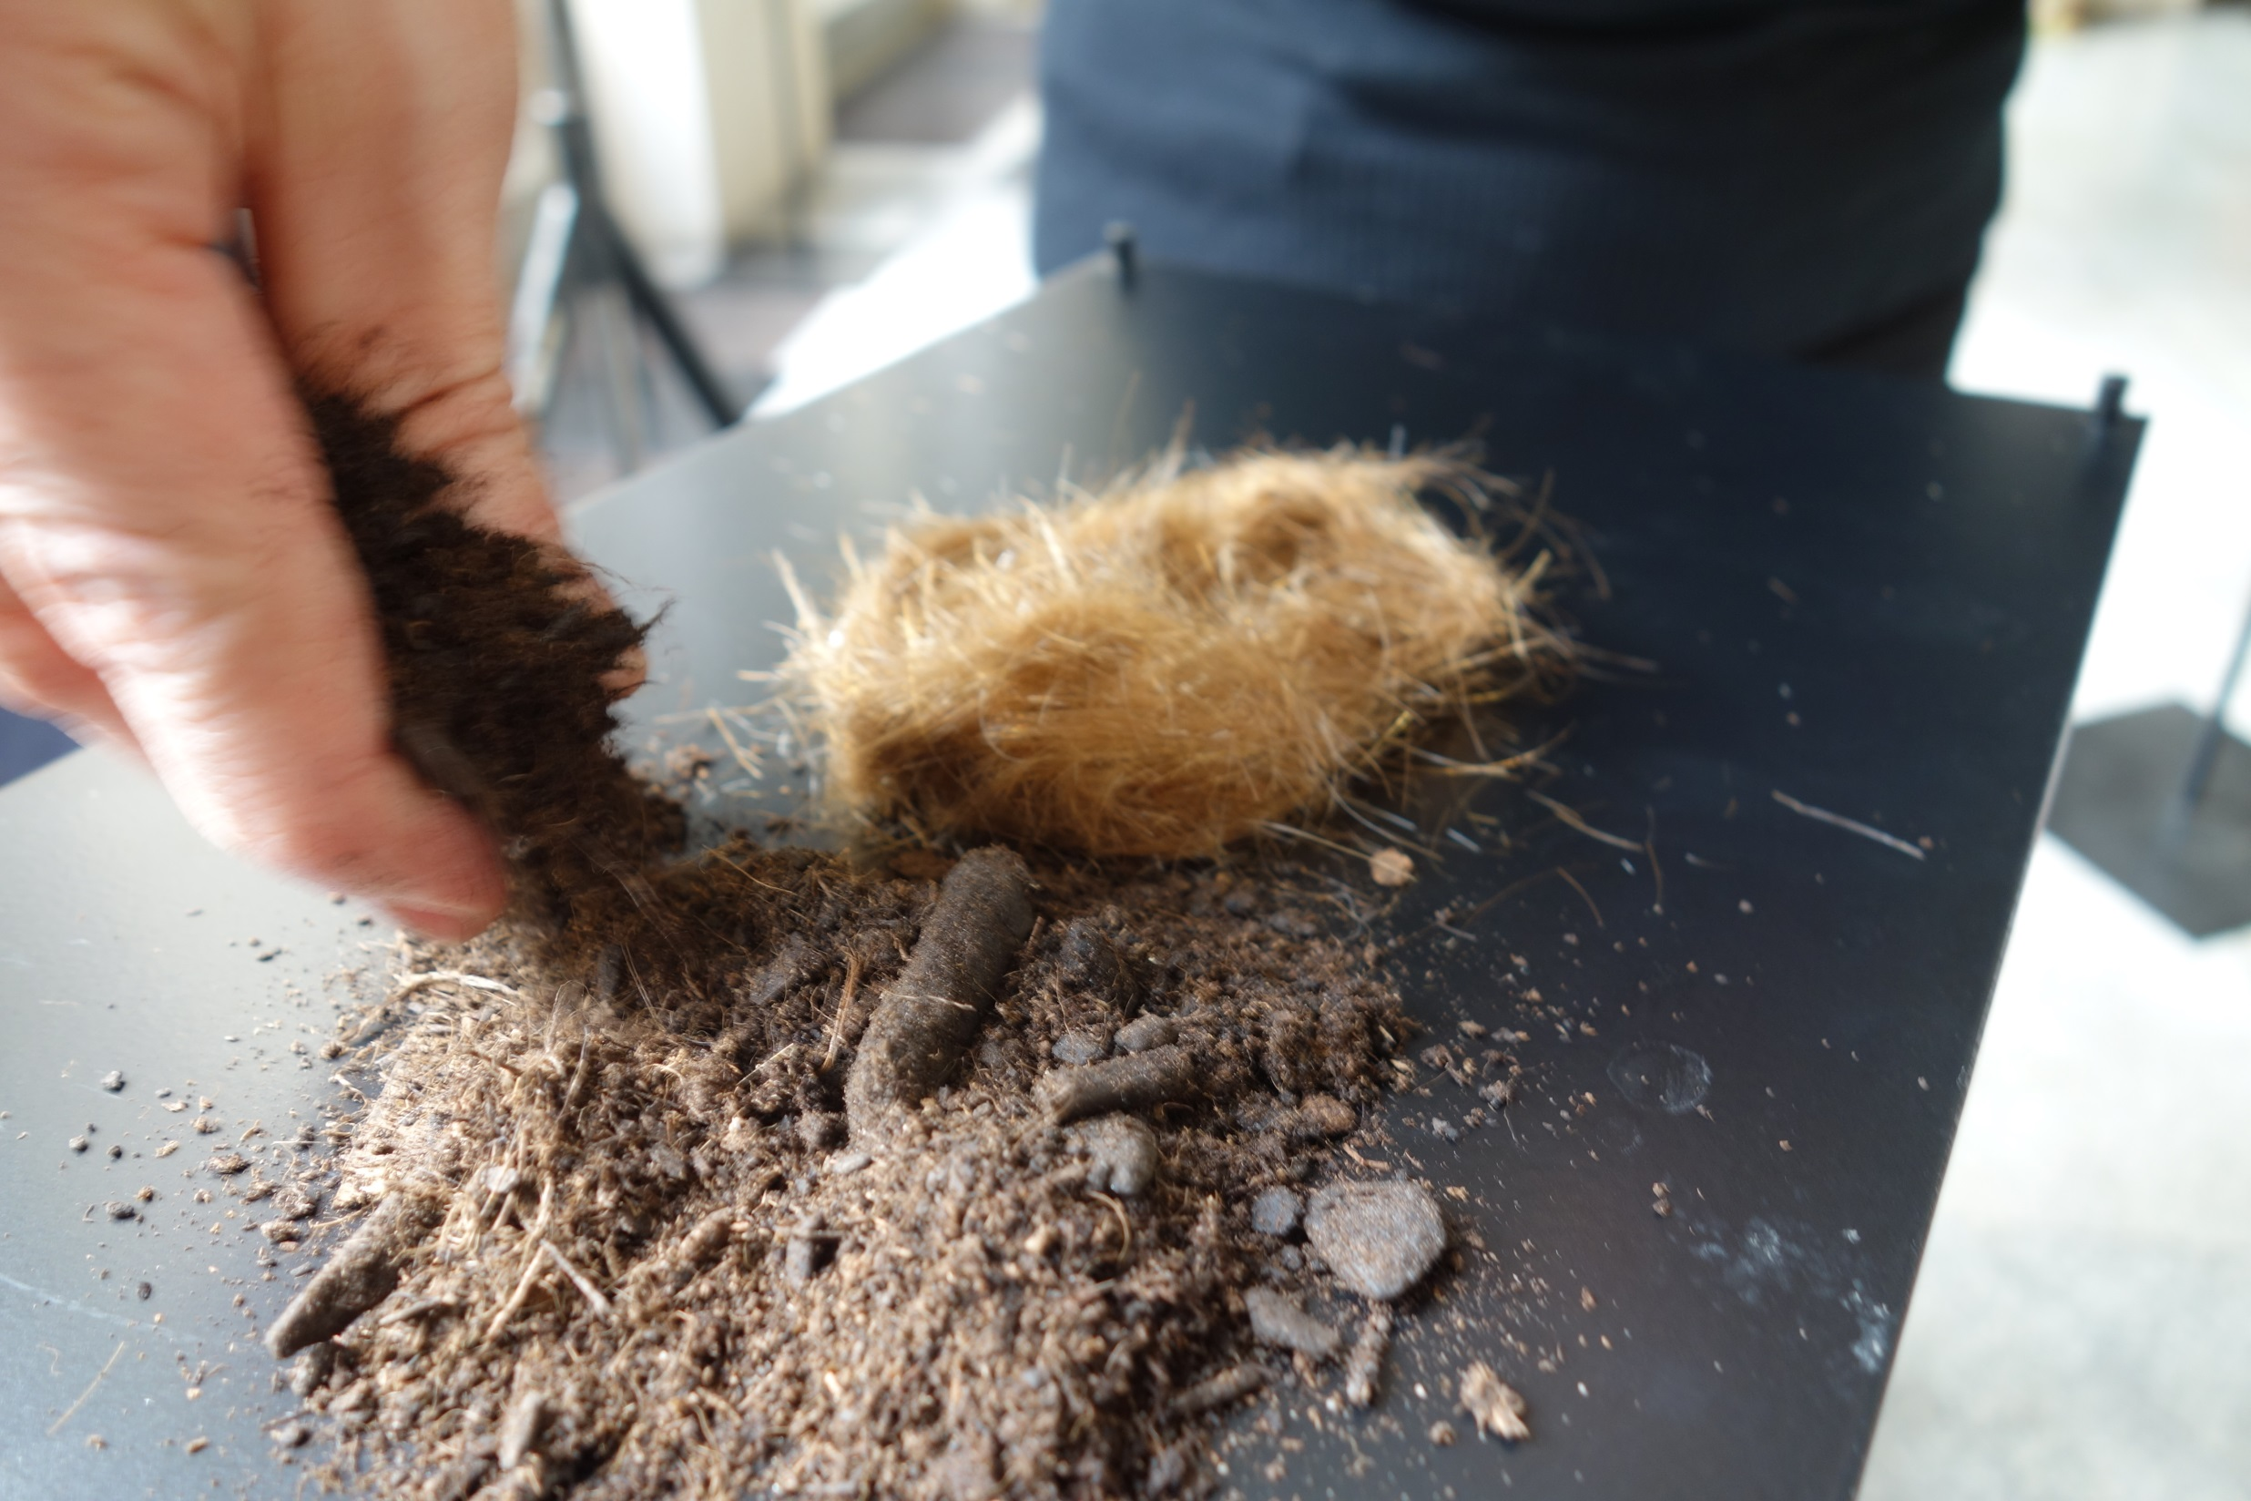
Energy is something that puts everything into motion.
Aristotle

